Slide 1
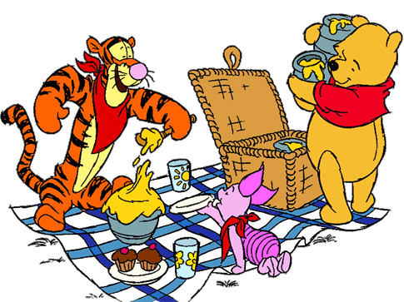
Unit 4: What do you want?

Slide 2
fly
I want a hot dog.

Slide 3
jump
I want an egg.

Slide 4
swim
I want a cupcake.

Slide 5
sing
I want some bread.

Slide 6
sing
I want some juice.

Slide 7
swim
I want some milk.

Slide 8
swim
I want some tea.

Slide 9
a
some
an

Slide 10
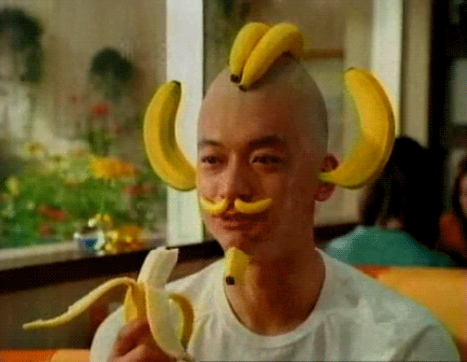
___ bananas

Slide 11
____ apple

Slide 12
___ watermelon

Slide 13
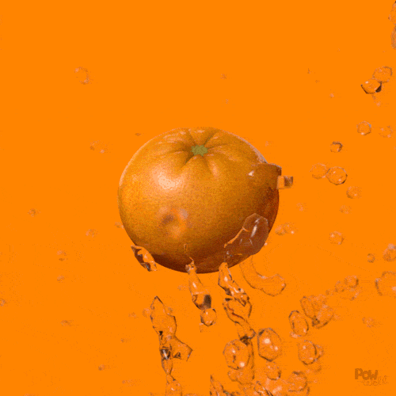
___ orange

Slide 14
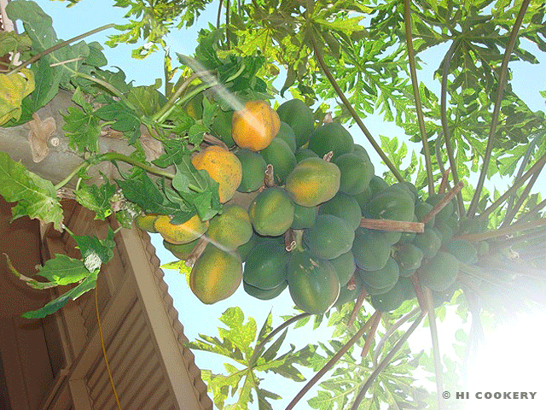
____ papayas

Slide 15
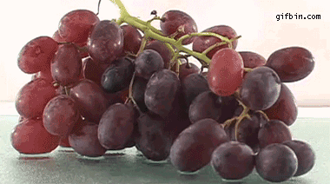
____ grapes

Slide 16
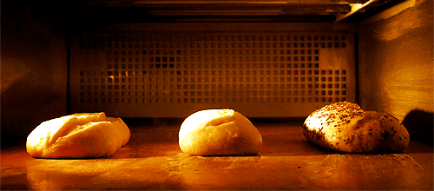
____ bread

Slide 17
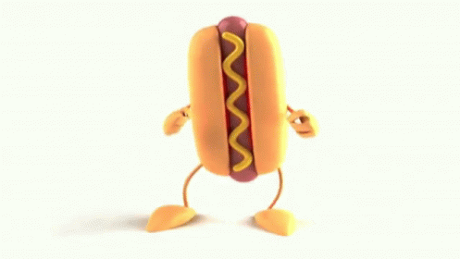
_____ hot dog

Slide 18
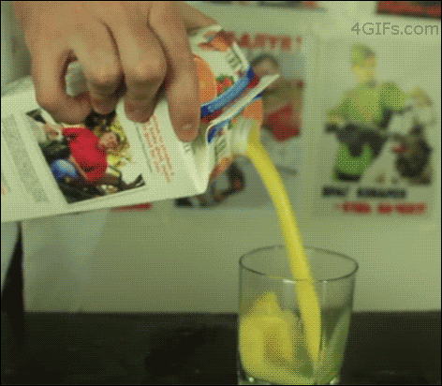
____ juice

Slide 19
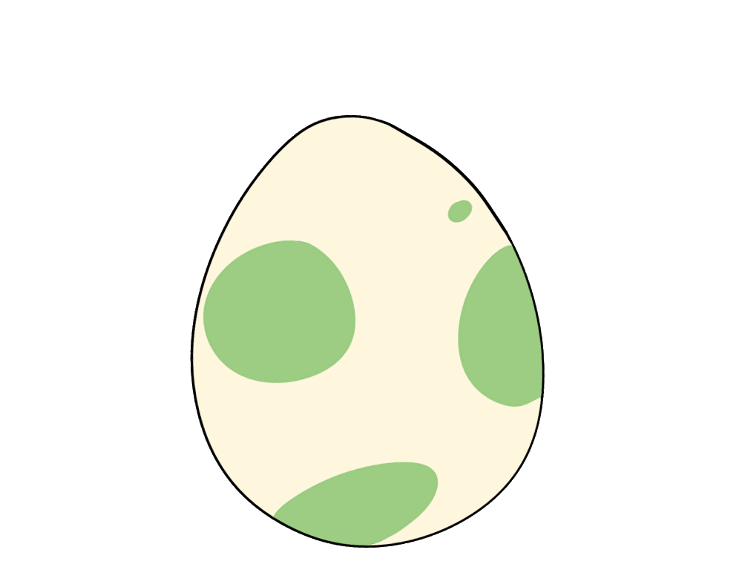
_____ egg

Slide 20
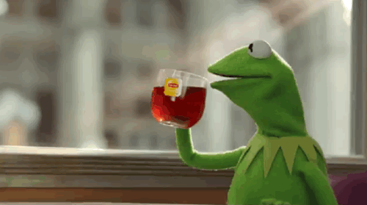
____ tea

Slide 21
_____ cupcakes

Slide 22
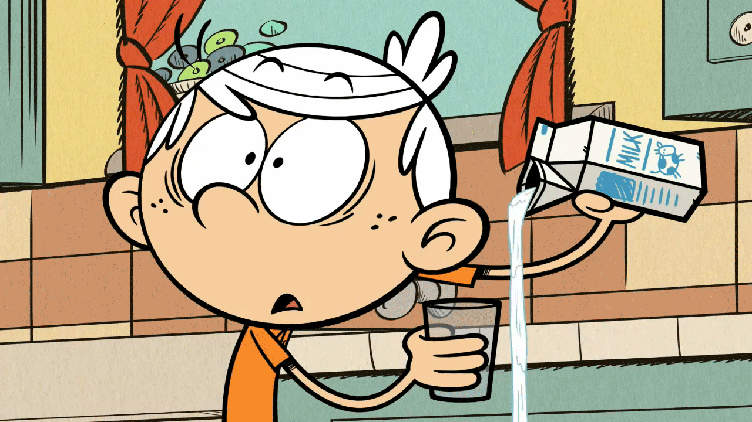
____ milk

Slide 23
Homework this week
寫:英語習寫本上黏貼的學習單。
聽:CD2(第32~37首)，每聽3遍請家長簽名。
背:Unit 4七個食物單字，下週小考。

Slide 24
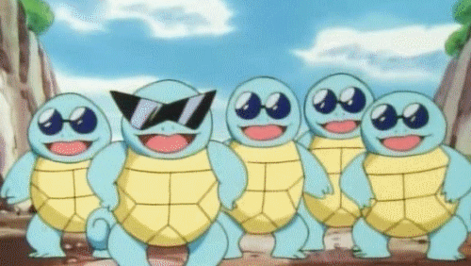
Story Time!!!! (P54)

